Slide 1




CCD Camera Imaging based on Monte-Carlo Algorithm
Group 12
Sponsor： HASCO Vision
Instructor： Yong Long

Slide 2

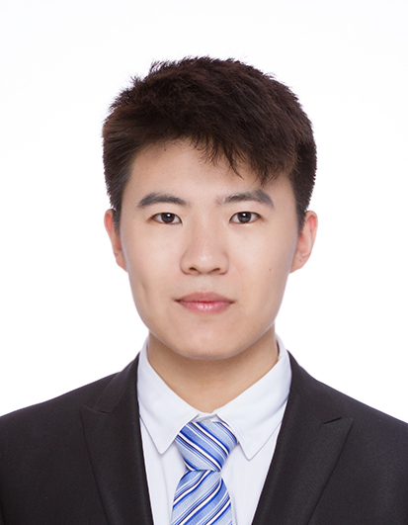
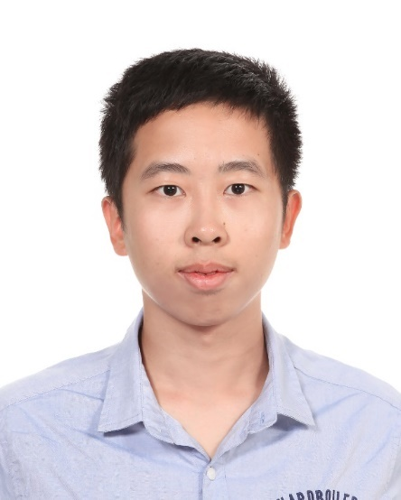
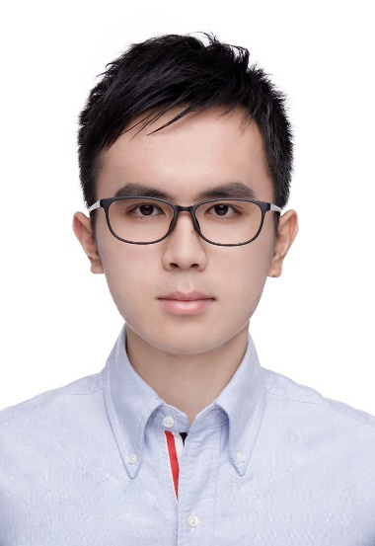
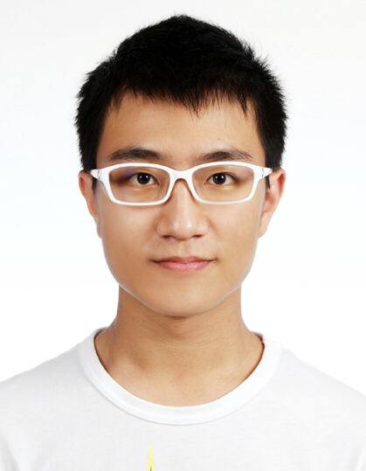
Members
Tianxin Shen
Xiao Liang
Jinde Yang
Long Shen
Yuming Tseng

Slide 3
Introduction

Slide 4


Introduction
Higher appearance requirement of automobile lights
Increase in analog requirements & lighting uniformity
Monopoly of foreign software
Problems
Human eye visual simulation of automobile lights
Higher lighting uniformity & analog accuracy
Getting rid of dependence on foreign software
Needs
Develop a visual imaging simulation software

Slide 5
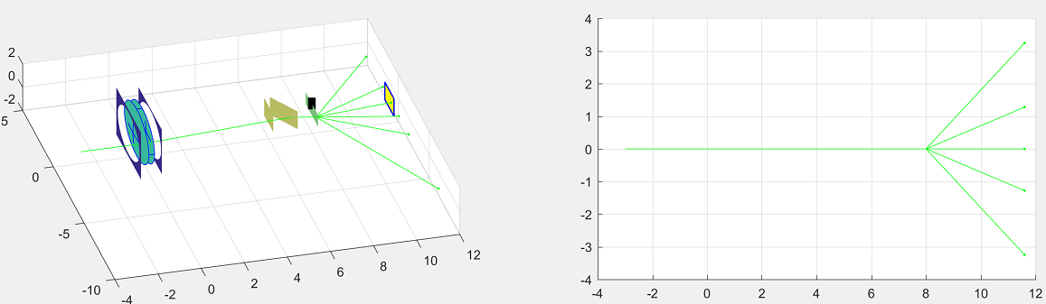
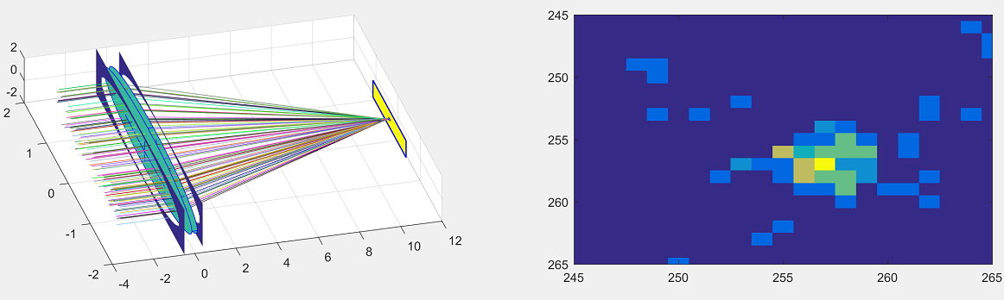
CR & ES
Customer requirements
Develop the algorithm for vision simulation & a workable software based on C++
Specific engineering requirements
Efficiency: time to process massive ray data | Number of adjustable parameters: robustness and flexibility
Accuracy: quantitatively comparison with experimental results | Pixel: the quality of the output picture
Size of output file | Cost: budget within 5000RMB
Fig 1. Matlab simple optical simulation. Copyright (c) 2010, B. Gustavsson

Slide 6
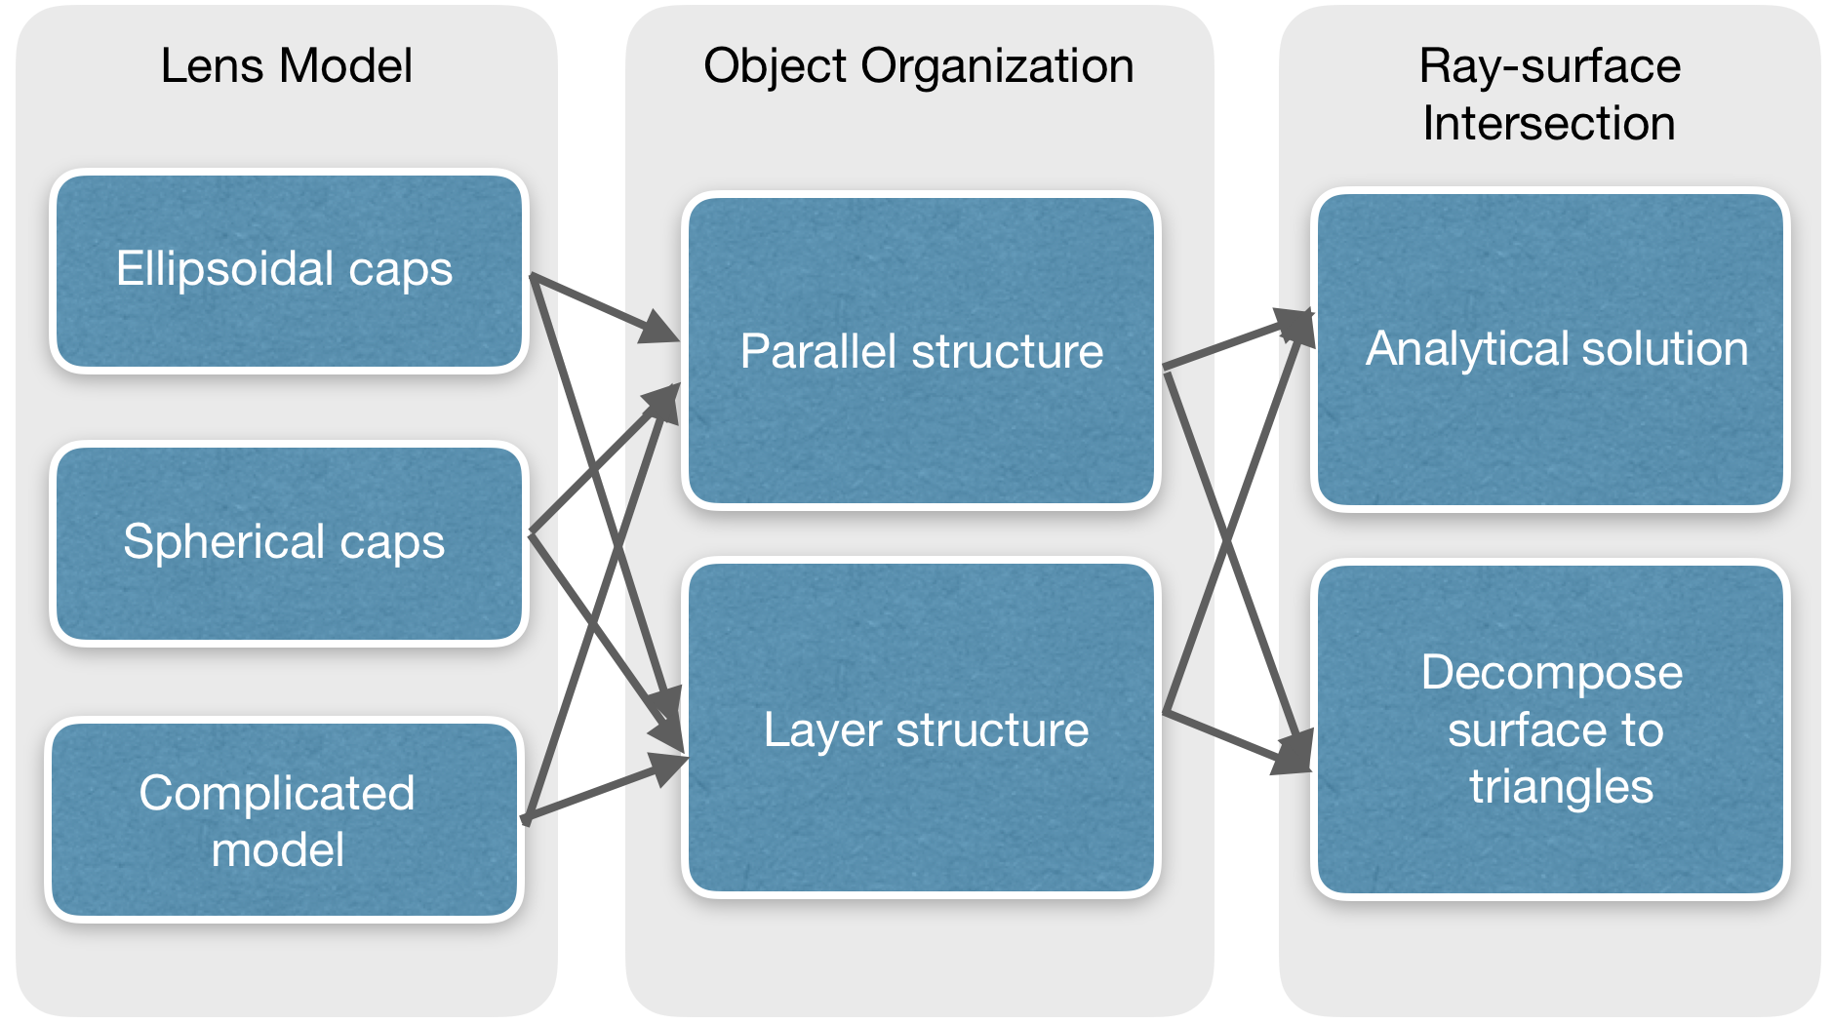
Concept Generation
Morphological Analysis Method
Functional Decomposition:
reading ray files
setting up geometric model for camera
propagating ray in camera
writing BMP file
Fig 2. Morphological chart

Slide 7
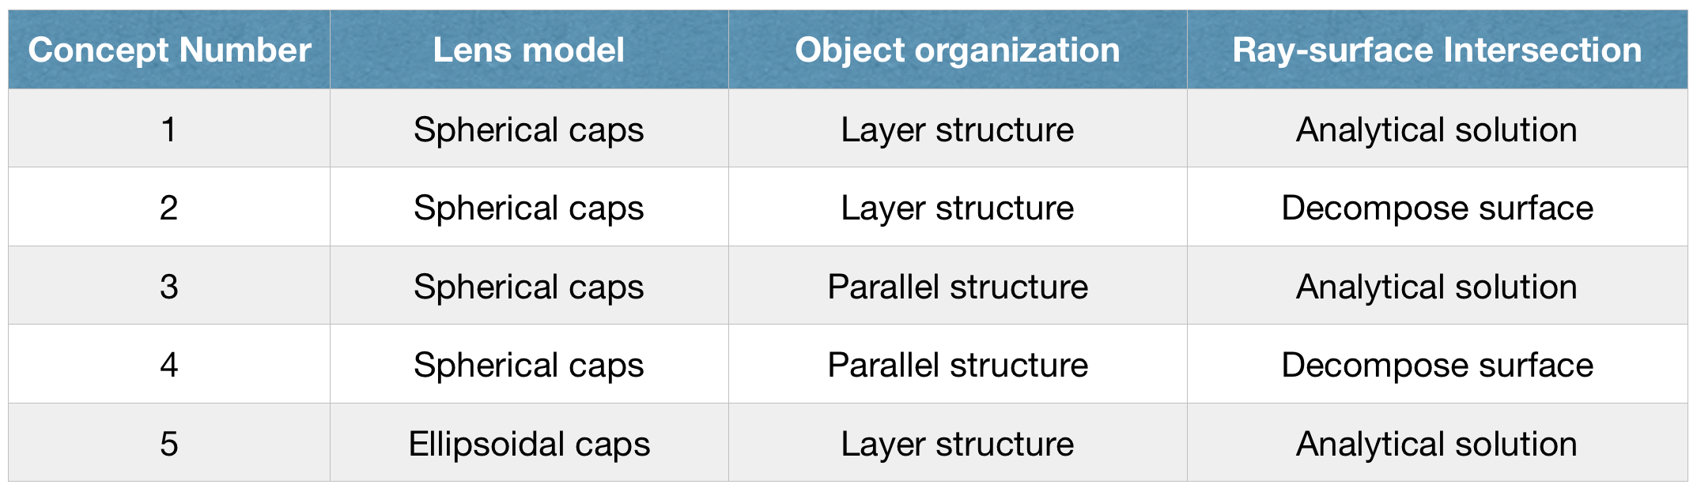
Concept Selection
Scoring Matrices
1. Generate design criterions from engineering requirements:
Programming time / Flexible ray parameters / Flexible optical apparatus parameters / Running speed / Portability / Accuracy / Mass data processing capacity
2. Compare each of the physical solutions for each sub function
3. Find spherical caps, layer structure and analytical solution highest score
Table 1. Concept generated

Slide 8
Parameter Analysis

Slide 9
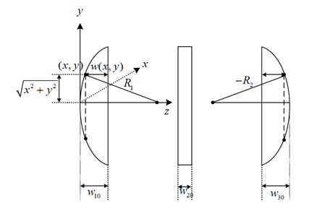
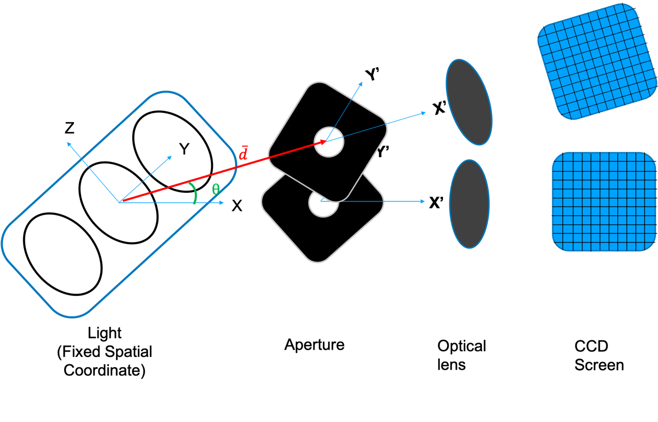


Parameter Determination
Determined from referential experiments
Aperture: aperture radius
CCD screen: height and width of the screen; pixel size(m*n)
Relative distance among the light, aperture, lens and CCD screen
Shooting angle
Determined from physical model
Optical lens:
Refraction Index: n
The focus length: f
The radius of Curvature: R
(assume R = $R_{1}$ = $R_{2}$)
$$\frac{1}{f}=\left(n−1\right)\left[\frac{1}{R_{1}}+\frac{1}{R_{2}}−\frac{\left(n−1\right)ω_{0}}{nR_{1}R_{2}}\right]$$

Slide 10
Mathematical Model-- Intersection
Plane:（Both aperture and CCD screen）
$$\overline{n}$$
$$P_{0}$$
$$t_{r}$$
Hook face:（Lens surface）
$$P_{r}$$
$$r$$
$$c$$

Slide 11
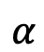
Mathematical Model--Refraction Direction
1
Get the intersection point
2
Build a new coordinate frame
3D Snell’s law 2D Snell’s law
3
Get the emergence angle
Transfer back to 3D direction
$$\overline{z}$$
$$\overline{y}$$
$$\overline{x}$$
$$β$$
$$α$$
$$(x,y,z)$$

Slide 12
Final Design

Slide 13
Algorithm Details
I. Modeling of camera
II. Read a ray from file
III. Perform ray propagation in camera
IV. Output simulation image

Slide 14
Algorithm Details
I. Modeling of Camera
Geometric modeling of aperture, lens & CCD
Simulation parameters
Determine the position of camera in coordinate
II. Read a ray from file
Starting point
DIS file
Direction
Intensity

Slide 15
Algorithm Details
III. Perform Ray Propagation in Camera
Layer 1: aperture
Layer 2: lens
Layer 3: CCD
IV. Output simulation image
Computing Intersection
Computing Intersection
Computing Intersection
CCD
Intensity Matrix
Brightness Matrix
BMP file
No
Yes
No
Yes
No
Yes
Original
Ray
Update
Ray
Update Ray
(Snell’s Law)
Add to Intensity
Matrix
Abandoned

Slide 16

Efficiency & Accuracy
Efficiency:
$𝒪\left(1\right)$ （constant complexity） for each ray
Work well with 200 million rays
Accuracy:
Follow principle of geometric optics

Slide 17
Prototype Description

Slide 18
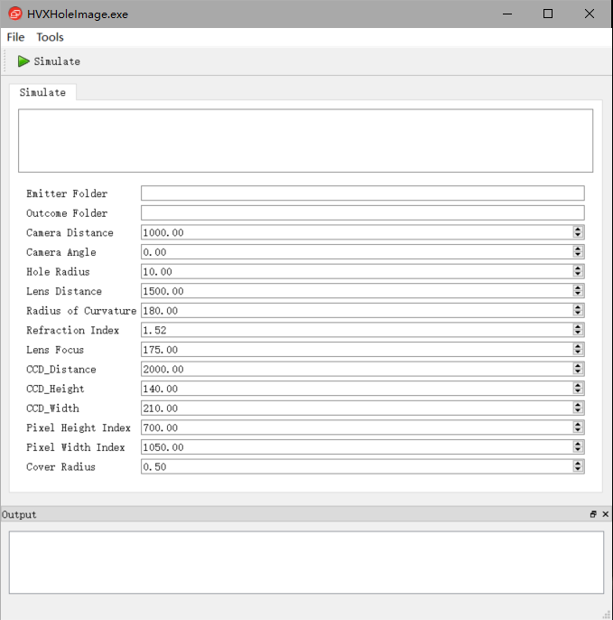
Prototype Description
Programming language: C++
Development environment: Visual Studio 2010, Qt 4.8.6
Libraries: OpenCV 3.0.0-Beta
File Path
Optical Parameters
Image Settings

Slide 19
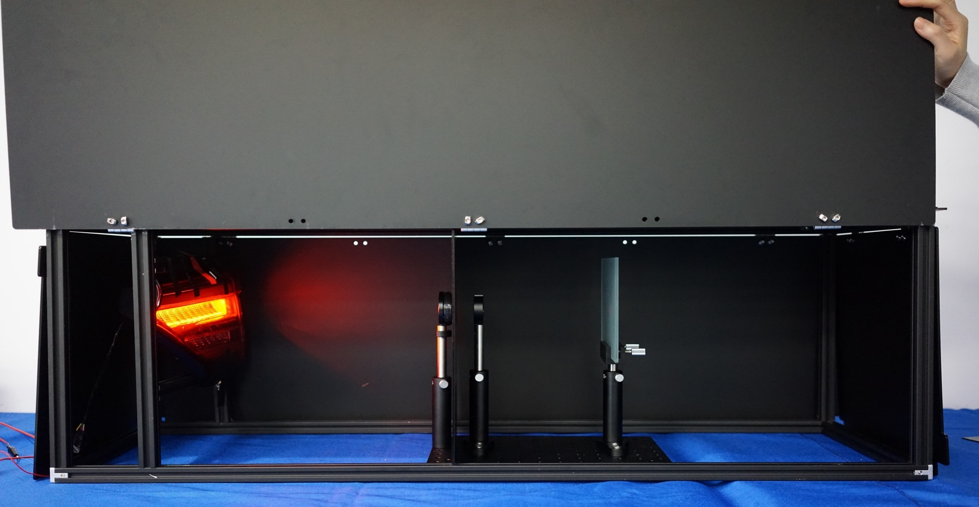
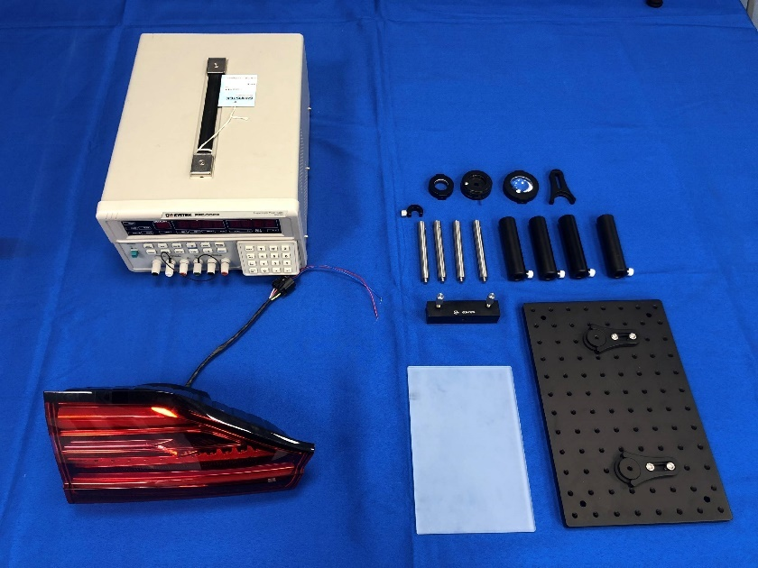
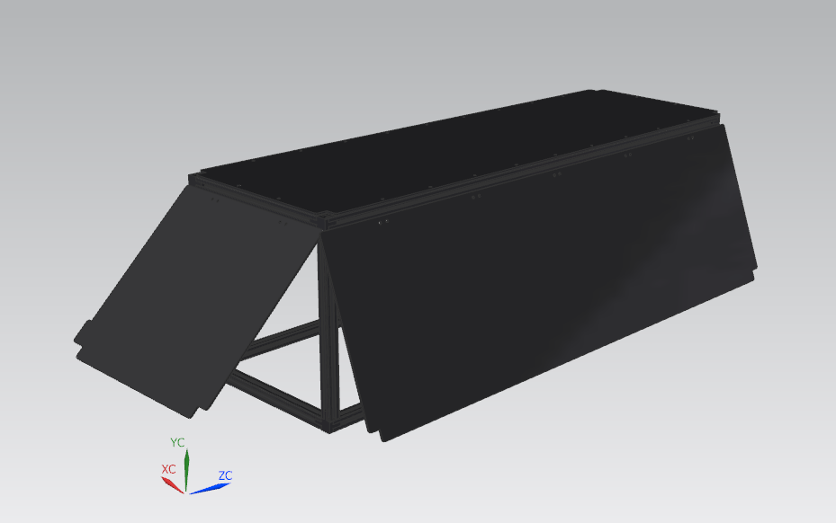
Prototype Description
Light Source
Aperture
(2-29mm)
Convex Lens
Optical Screen
Fig 3. Light source & optical elements
Fig 4. Dark box
Fig 5. The overall setup

Slide 20
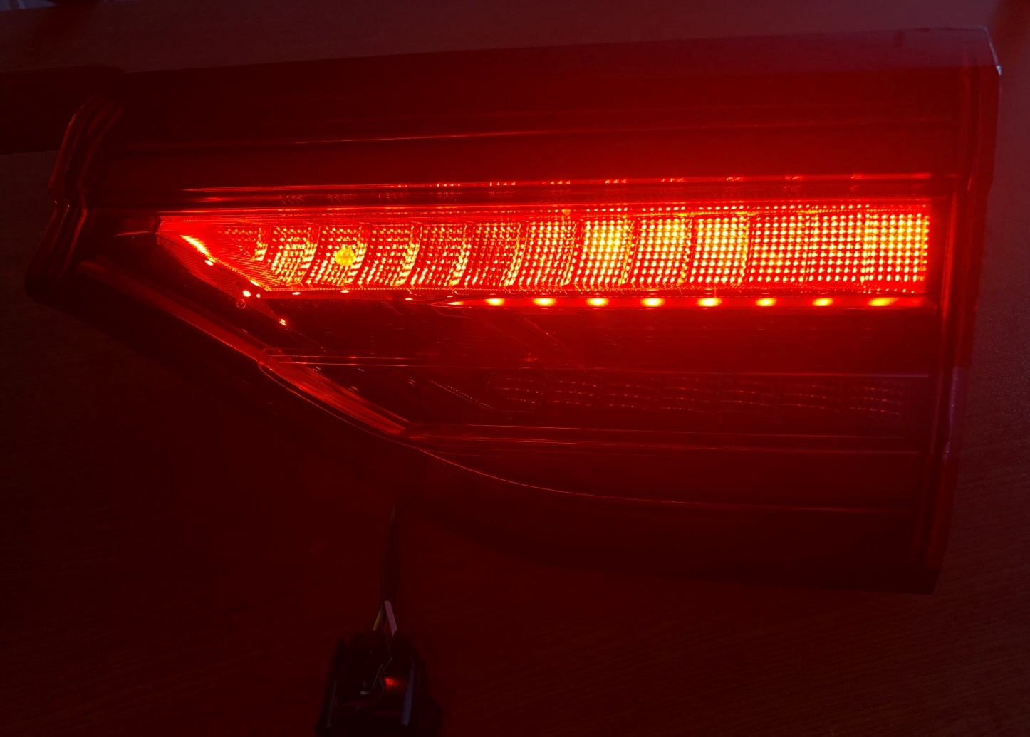
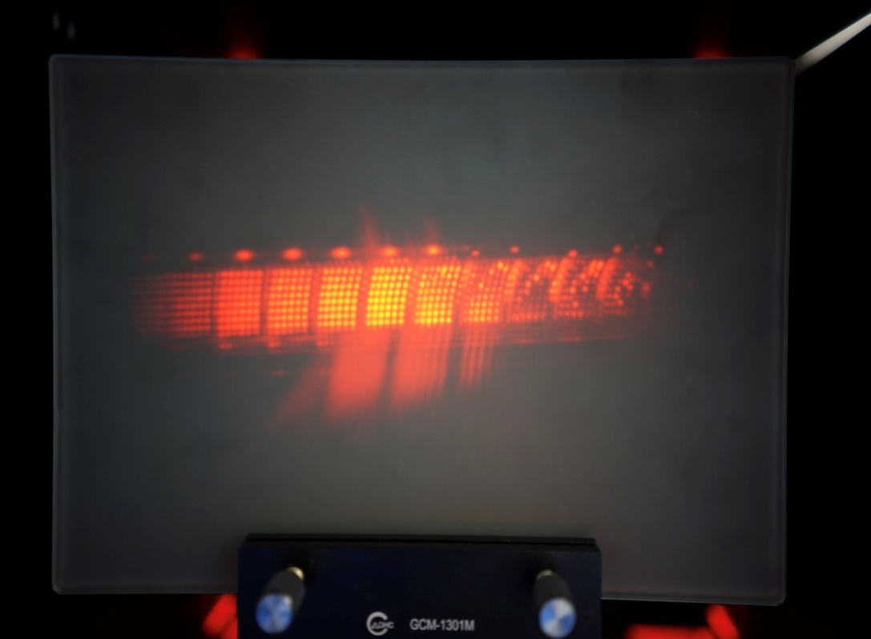
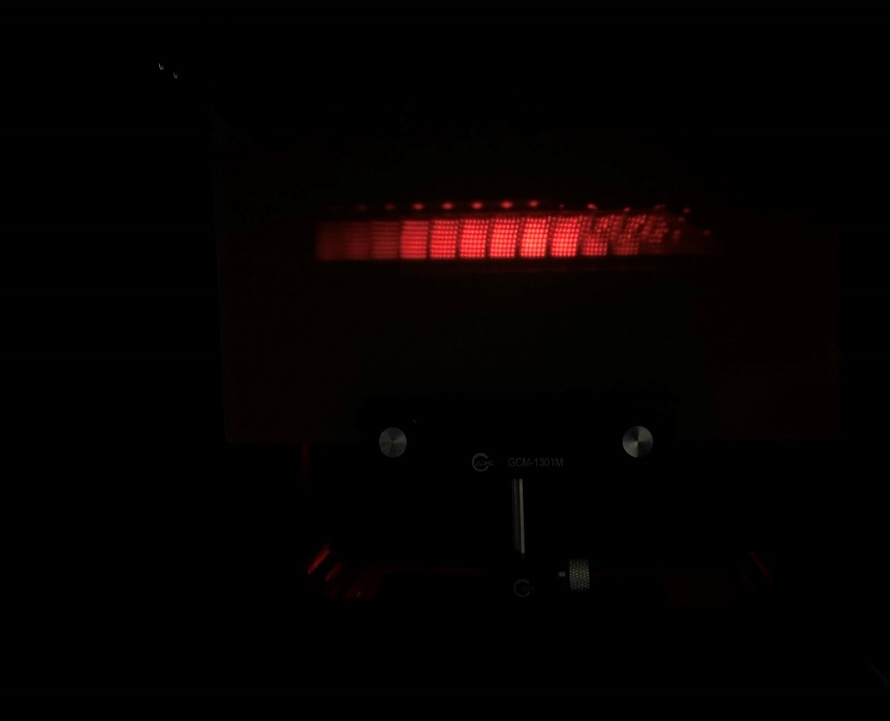
Prototype Description
Fig6. Image 1
Fig 7. Image 2
Fig 8. Light source

Slide 21
Test Result

Slide 22
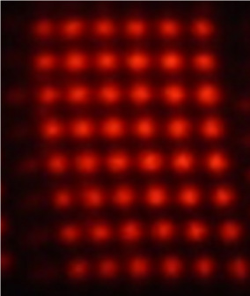
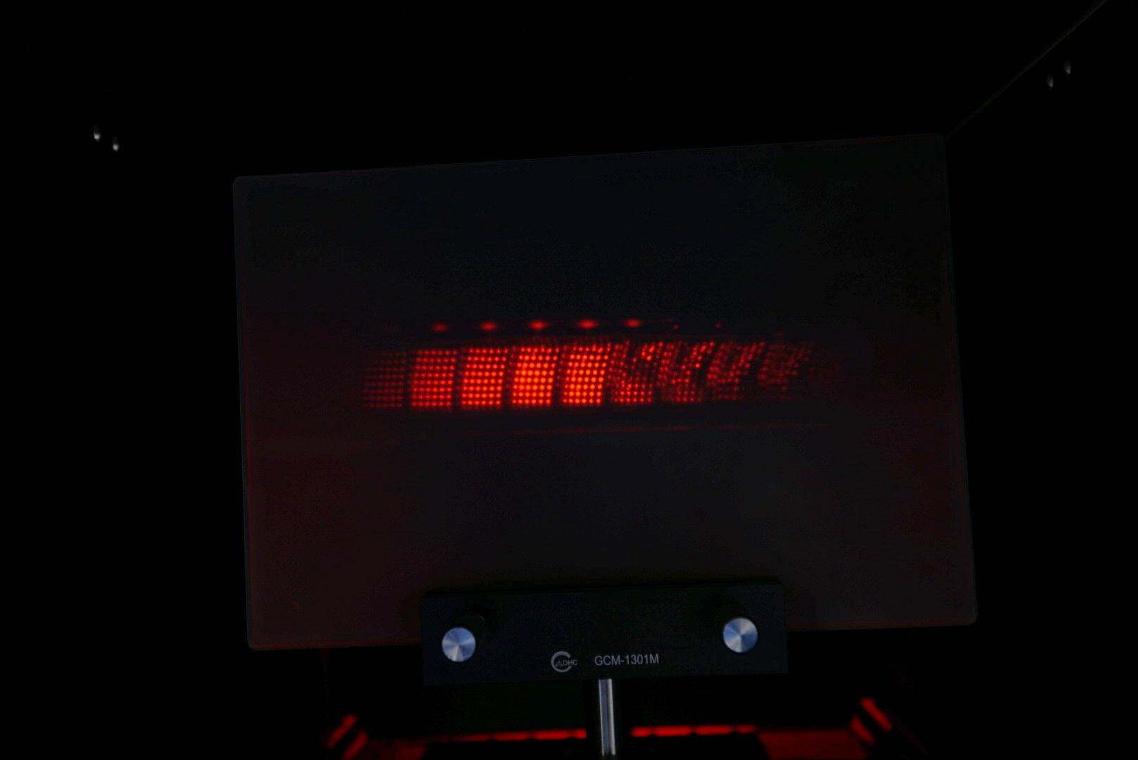
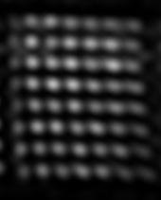
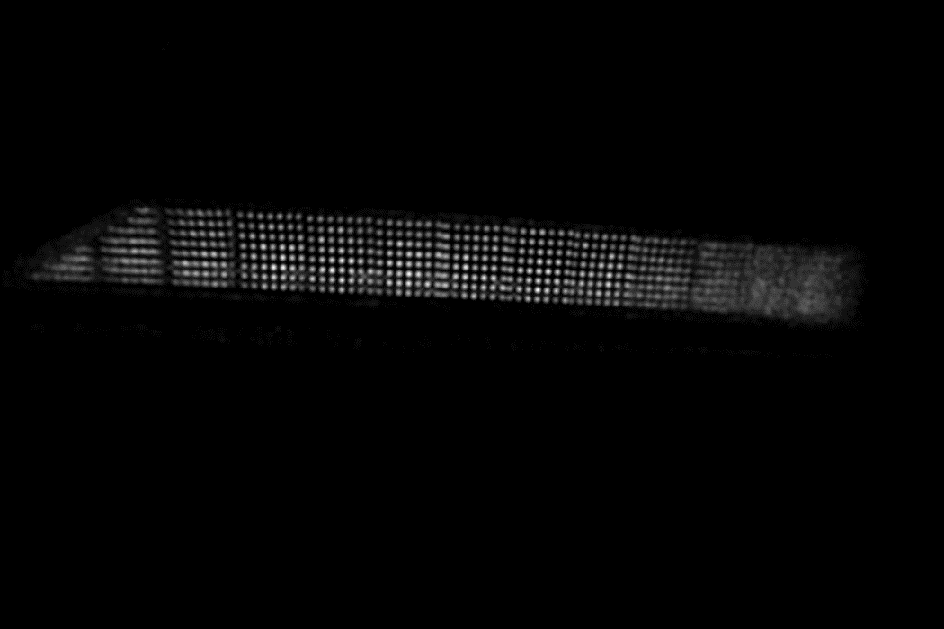
Test Result
Fig 9. Referential figure (up) and simulated figure of the taillight (down).

Slide 23
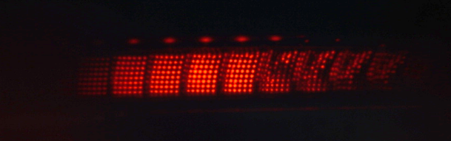
Test Result
Item | Requirement | Actual data
Size of output picture | 2MB | 721KB
Running time (200 million rays) | 500s | 165s
Resolution (adjustable) | 800*600 | 1050*700
Error (LED distance ratio) | 20% | 5%
Error (number of LED) | 20% | 3.6%
Error (total) | 40% | 27.6%
LED distance ratio: x/y
Number of LED: N
Overall comparison
x
1
2
3
y
N-2
N-1
N

Slide 24
Discussion
Strengths
- High accuracy: 5% distance error, 3.6% number error and 27.6% total error
- Massive data analysis: 100,000,000 rays
- Complete function in user-interface
Weakness
- Gray scale images
- Relatively slow: 165s for 100 million rays
- Simple geometric optics: convex lens, aperture and screen
Improvement
- RGB images
- Multithread: speed up
- Consider physical optics: diffraction, scattering…

Slide 25
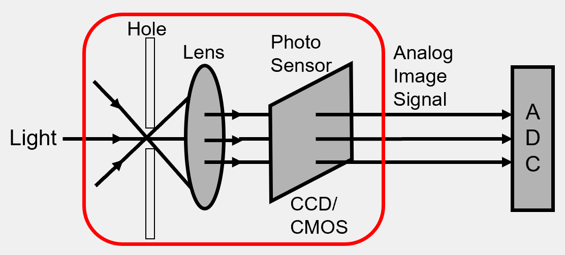


Conclusion
Objective: Derive a 3D optics imaging simulation software for CCD camera.
Solution: Build up an optical imaging system based on C++ and create UI to integrate all the adjustable functions.
Outcomes: The system can simulate images according to the input rays with higher than 70% accuracy.
Achievements: Utilize software to simulate optical imaging successfully.

Slide 26
1. OPTIS-SPEOS, Official Site, URL: https://www.optis-world.com/product-offering-light-simulation-virtual-reality-software/SPEOS, online.
2. Wang Zilong and Xiao Shuangjiu, " Simulation of Human Eye Optical System Properties and Depth of Field Variation," International Journal of Machine Learning and Computing, Vol. 3, No. 5, pp. 413-418, Oct 2013.
3. Li Na; Ding Ya-lin; Leng Xue; Zhou Jiu-fei; Zheng Fei, “Analysis and Design of Linearity CCD Camera Simulation System,” Appl. Dec.24, 922-7 (2009)
4. N. Bhattacharya, H. B. van Linden van den Heuvell, and R. J. C. Spreeuw, “Implementation of Quantum Search Algorithm using Classical Fourier Optics,” Phys. Rev. Lett. 88, 137901.
5. CHEN X, YU Q, YANG D, TAN H, “Ray tracing based optical camera simulation imaging method, involves performing image degeneration process to obtain analog circuit simulation image, and obtaining digital quantized simulation image to output digital image of camera,” BEIJING TECHNOLOGY INST(BEIT-C), CN107092752-A
References

Slide 27
THANK YOU！
CCD Camera Imaging based on Monte-Carlo Algorithm

